Slide 1

Improving Concrete by using Slag Cement
Jay Whitt
Technical Service Engineer
Lehigh Cement

Slide 2

Presentation Notes
Find presentation slides and post event recording at: slagcement.org/videos
Listen only mode.
Ask questions in the dialog box in GoToWebinar

Slide 3
Disclaimer
As with all concrete mixtures, trial batches should be performed to verify concrete properties. Results may vary due to a variety of circumstances, including temperature and mixture components, among other things.
You should consult your slag cement professional for assistance. Nothing contained herein shall be considered or construed as a warranty or guarantee, either expressed or implied, including any warranty of fitness for a particular purpose.

Slide 4
Learning Objectives
In this webinar, we will explore how slag cement can be used to enhance the durability, resilience and sustainability of concrete structures. Attendees will learn what slag cement is, its chemical components, how it can be used to combat ASR and sulfate attack, and what specifications are related to its use.

Slide 5

Todays Speaker
Jay Whitt is with Lehigh Cement as a technical service engineer in this local region, including Ohio and Indiana region.
He has been in the cement and concrete industry since 2000 specializing in providing product technical support to customers while managing innovative portfolios including research, lab testing, and customer implementation.
He is active in ACI National committees on Hydraulic Cement, Slag Cement, and Mass Concrete. Jay earned a BS and MS in Civil Engineering from the University of Akron where he co-opted with ODOT construction in District #4, completed research in Slag Cement, and raced concrete canoes.
Notes:
Remove speaker slide if using in class.

Slide 6



Copyright Materials
This presentation is protected by US and International copyright laws. Reproduction, distribution, display and use of the presentation without written permission of the speaker is prohibited.
© Lehigh Hanson 2018 & SCA
Member Company
Professor Doug Hooton

Slide 7

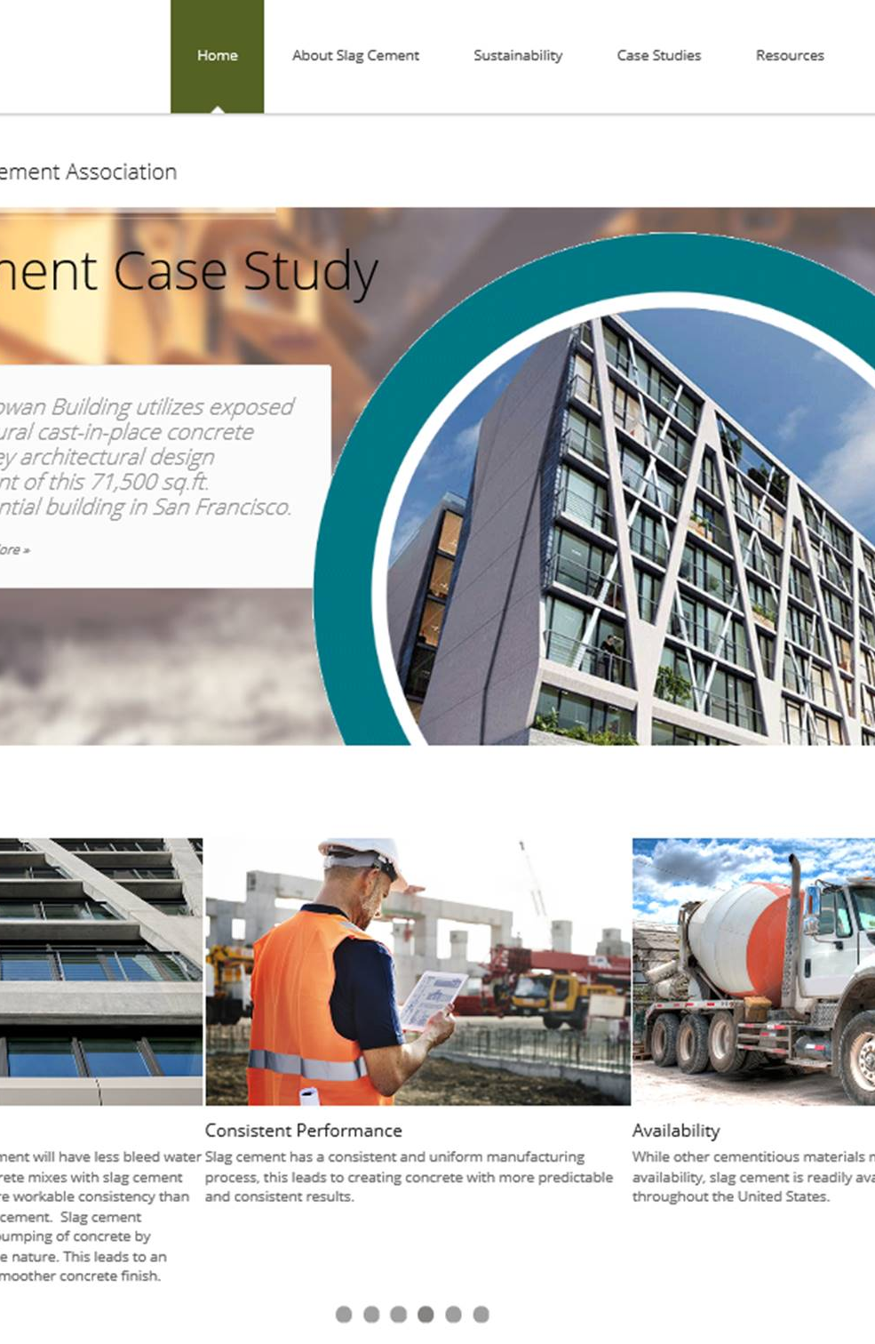
Website resources
www.slagcement.org

Slide 8
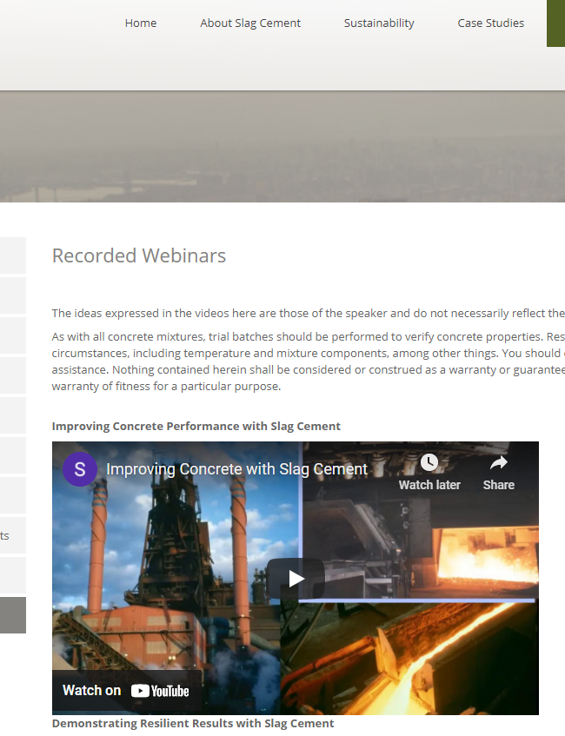
Webinars
www.slagcement.org

Slide 9
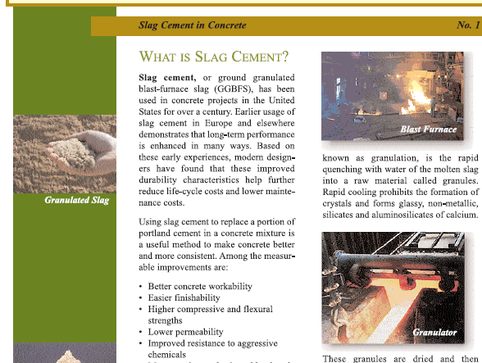
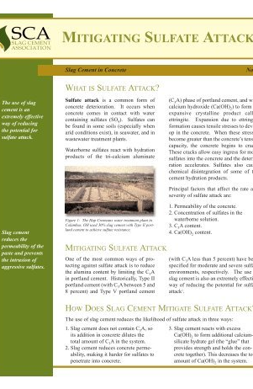
Technical Information Sheets
www.slagcement.org

Slide 10
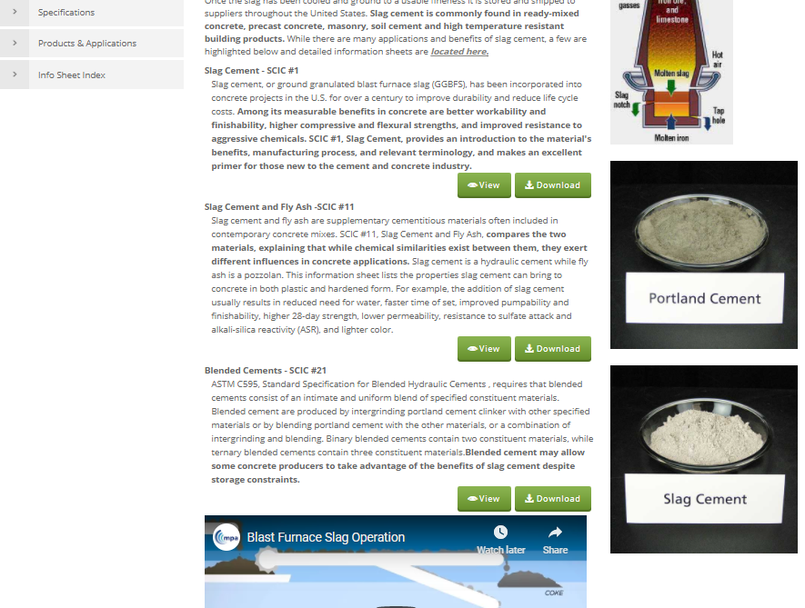
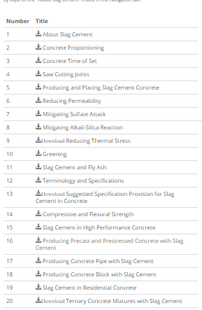
Technical Information
Sheets
www.slagcement.org

Slide 11


State Specific Info & Videos
www.slagcement.org

Slide 12
Improving Concrete by using Slag Cement
Jay Whitt
Technical Service Engineer
Lehigh Cement

Slide 13
Overview of Slag Cement
Why use a SCM
Cementitious hydration advantages
Overview of Performance
Positive effects in concrete
Durability benefits
Applications using slag cement
Environmental benefits
Defining & the specifications
Agenda

Slide 14
SCMs: Why Complicate the Mix?
(If portland cement has worked, why add Supplementary Cementitious Materials such as Slag cement?)
To use up Ca(OH)2 byproduct of cement hydration to form more Calcium-Silica Hydrates (C-S-H)
To strengthen the aggregate/paste bond in the Interfacial Transition Zones (ITZ) around aggregate
To remove excess alkalis from pore water
To increase binding of chloride ions in aluminate phases
To increase sulfate resistance
To help lower heat of hydration.
To reduce “energy” & environmental footprint
Notes:
reducing porosity and improving properties.
reducing permeability
binding alkalis in Al-containing, lower Ca/Si C-S-H to prevent ASR.
To increase binding of chloride ions in aluminate phases
To obtain better sulfate resistance.
To help lower heat of hydration.
by reducing the amount of portland cement clinker in concrete.

Slide 15
What is Slag Cement
www.slagcement.org

Slide 16

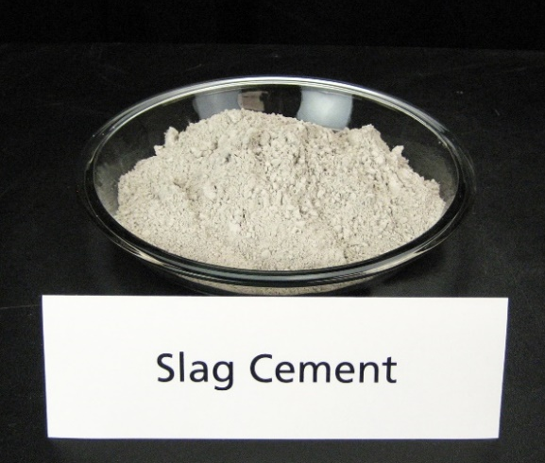
Slag Cement
Defined by ACI Committee 116:
  “Granulated blast-furnace slag that has been finely ground and is a hydraulic cement.”
Formed when molten slag, diverted from an iron blast furnace, is rapidly chilled producing glassy granules ground to cement fineness
Dosage rates for concrete applications range from 20% to 50% replacement of the cementitious material by mass. (with mass concrete applications up to 80%).

Slide 17
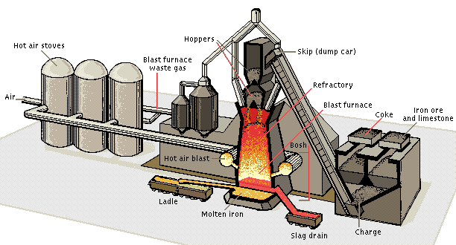
Schematic of Blast Furnace:
Molten slag is tapped off every few hours and slag for use in slag cement is rapidly quenched in a granulator

Slide 18
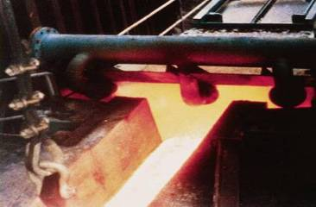
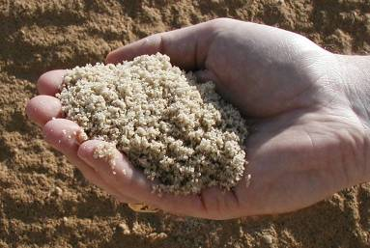
What is Slag Cement?
Slag Cement has similar chemistry to portland cement (almost the same chemical elements, although in differing percentages)
Non-metallic product of an iron blast furnace
Granulated then ground to a fine powder
Cementitious material: ASTM C989 specifies three different Grades (80, 100, 120)
Notes:
Both contain almost the same chemical elements, although in differing percentages

Slide 19
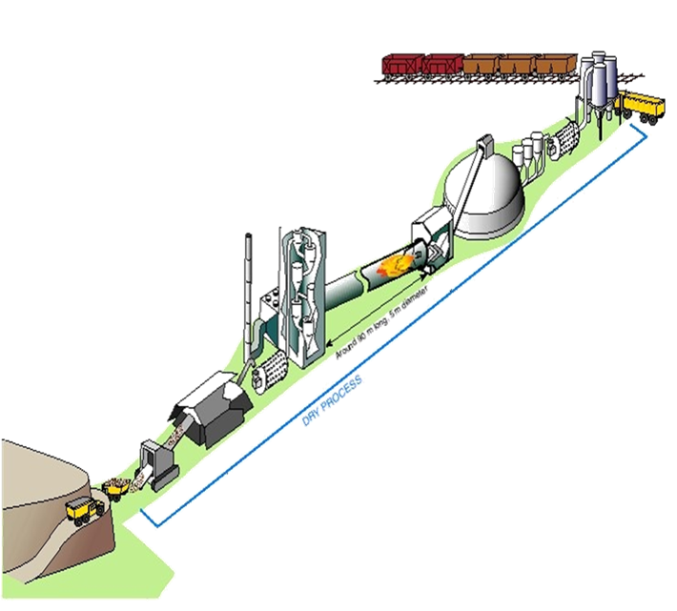
Slag granules introduced into the finish mills

Slide 20
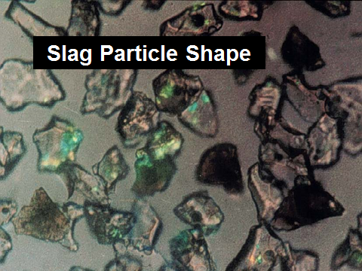
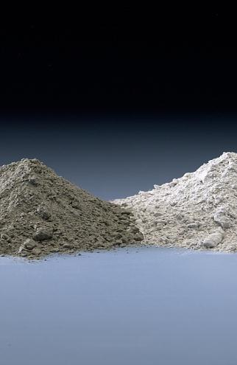
Physical Characteristics of Slag Cement

Slide 21
Typical Chemical Analysis
Chemistry similar to portland cement; both contain almost the same chemical elements, although in differing percentages.
 | Portland Cement | Slag Cement*
CaO | 65% | 38%
SiO2 | 20% | 36%
AI2O3 | 4% | 10%
Fe2O3 | 3% | TR
MgO | 3% | 11%
Alkalis' | 1% | 1%
* Percentages vary based upon the source of slag granules and cement mfg.

Slide 22
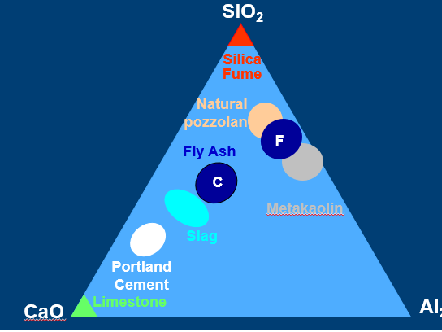
Slag Composition is closer to Portland cement than other SCMs

Slide 23
Slag Cement Specifications
www.slagcement.org

Slide 24

Standard Specifications
Slag cement as a Supplementary Cementitious Material (SCM) in concrete
    ASTM C989 or AASHTO M302 Standard Specification for Slag Cement for Use in Concrete and Mortar
    Specified through a Slag Activity Index to classify three grades of Slag Cement (Grade 80, 100, & 120)

Slide 25
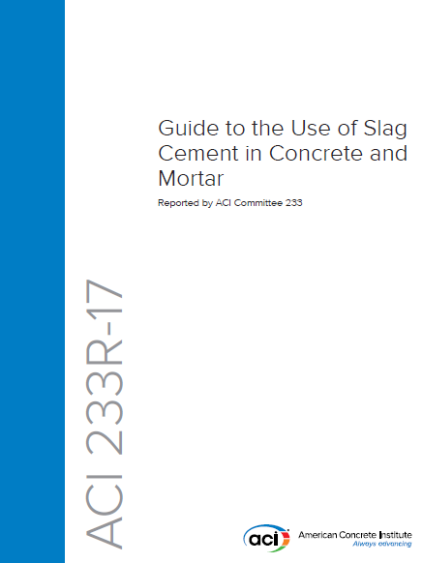
Reference Guide on Slag Cement
A good document to start with!
ACI 233
CHAPTER 1—GENERAL INFORMATION
CHAPTER 2—DEFINITIONS
CHAPTER 3—PROPERTIES AND PRODUCT TYPES
CHAPTER 4—STORAGE, HANDLING, AND BATCHING
CHAPTER 5—PROPORTIONING CONCRETE CONTAINING SLAG CEMENT
CHAPTER 6—EFFECTS ON PROPERTIES OF FRESH CONCRETE
CHAPTER 7—EFFECTS ON PROPERTIES OF HARDENED CONCRETE AND MORTAR
CHAPTER 8—SLAG CEMENT APPLICATIONS
CHAPTER 9—SUSTAINABLE DEVELOPMENT

Slide 26
Slag Cement Hydration
www.slagcement.org

Slide 27
Results of Cement Hydration:
The cement and water reaction will produce two primary hydration products: Calcium Silica Hydrate (CSH) and Calcium Hydroxide (CaOH). The CSH is referred to as the glue.
Cement
Water
CSH
CaOH
CSH
CSH
Cement
Water

Slide 28

Effect of the Slag Cement Reaction
Calcium Silicate Hydrate
Voids
and
Ca(OH)₂
Aggregate
Aggregate
Portland Cement
Slag Cement
Portland Cement
Concrete System
Portland-Slag Cement
Concrete System
Notes:
Schematically, the picture on the left shows what happens when ordinary portland cement (gray) hydrates. Calcium-silicate hydrate is formed (yellow), but there are significant areas where this “glue” is not present (voids).
The picture on the right shows that with slag cement (white), much more of the paste is filled with the Calcium Silicate Hydrate. The volume of voids is significantly reduced.
The increased formation of calcium silicate hydrate gives concrete made with slag cement more strength and reduces its permeability.
Greater bond is also formed with the aggregate particles, thus enhancing strength, particularly tensile/flexural strength. (Check Seattle presentation data on flexural strength info)

Slide 29
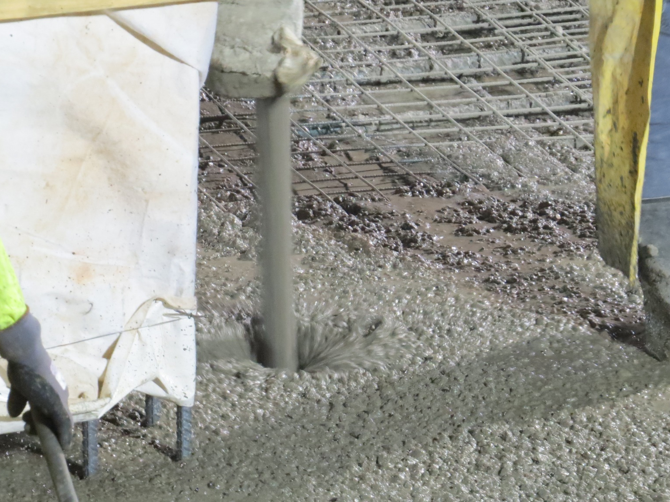
Effects on Plastic Properties
www.slagcement.org

Slide 30
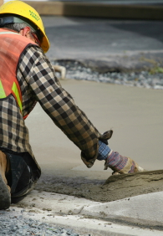
Effects on Plastic Concrete
Properties
Improved workability, consistency and place-ability (caused by particle shape and specific gravity)
Time of Setting
  Increased vs. reference Portland 1/2 hr.-1.0 hr. @ 73 F (23C) {effecting finishing time}
  Little change above 85 F
  More temperature sensitive than portland cement.
Reduced rate of slump loss
Concrete surface is eventually lighter (whiter) in color

Slide 31
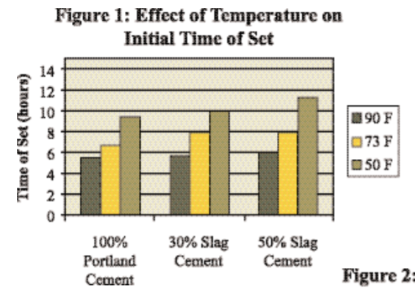
Effect of Temperature on Time of Set
At high replacement levels and in cold weather, time of set and early strength may be retarded.
This may require adjustments to mix proportions.
However, there will typically be less slump loss at both cool and warm temperatures
https://www.slagcement.org/portals/11/Files/PDF/IS-03.pdf

Slide 32
Set Time – portland vs slag cement
Lab Mixes at 70° F
550 lb. total cementitious (non-air), Type I/II, w/c = 0.48
Increasing slag %

Slide 33

Effects on Hardened Properties
www.slagcement.org

Slide 34
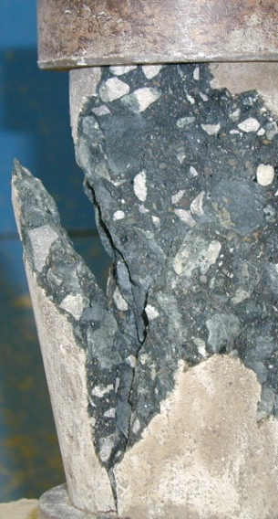
Effect of Slag Cement on Concrete Strength
Slag Cement has a positive impact on late strength gain.
The use of slag cement provides:
Greater compressive and flexural strength at later ages (7 days & beyond).
Less strength at early ages (1 to 7 days).
Optimum dosage for 28-day strength is dependent on:
Application
Time of year (temperature)
Replacement percentage

Slide 35
Effect of Slag Cement on Strength Gain
Slag Cement Replacement Percentages Experiment
Mix Design
600 lb. total cementitious,
Type I/II,
air mix,
w/c=0.47,
w/Type A water reducer

Slide 36

Durability Benefits of Slag Cement
Slag Cement mitigates ASR, increases sulfate resistance, reduces shrinkage, and Reduces Permeability and chloride ingress…
ACI 233 chapter 7

Slide 37
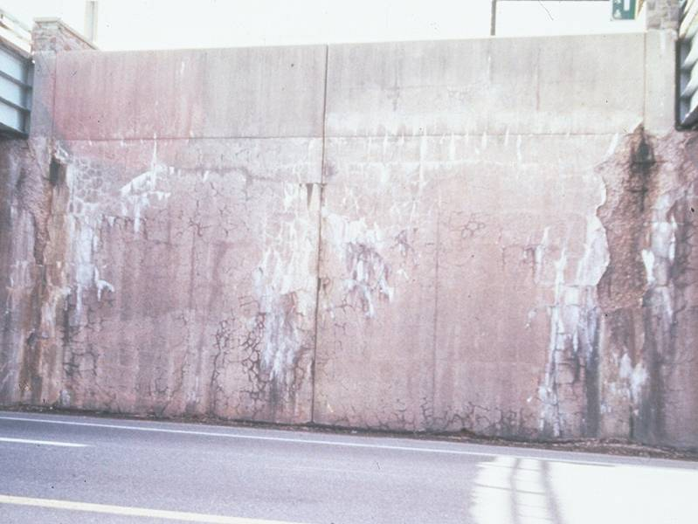
Slag Cement Mitigates Alkali Silica Reaction (ASR)
Slag cement reduces the potential of ASR
Reducing total alkalis in the system thus reducing the alkali-silica ratio.
Consuming alkalis in the hydration process, making them unavailable for the alkali silica reaction.
How
Reducing pore size then reducing alkali mobility.
Reducing the amount of pore liquid that reacts with the aggregate.
Reduces permeability.
Many studies showing replacement of 25 to 70% can result in effective mitigation of ASR.
ASR Photo Courtesy of the Slag Cement Association (SCA)

Slide 38
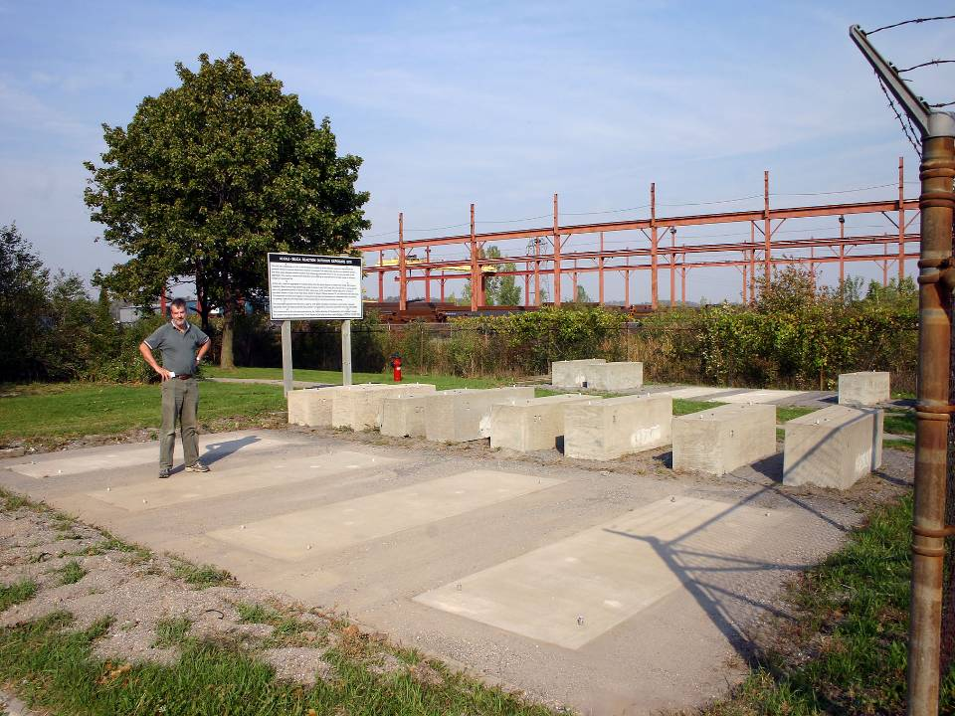
ASR Exposure Site Established in Kingston, Ontario in 1991
6 different concrete mixtures
reinforced and non reinforced
blocks and slabs
Spratt coarse aggregate and local non-reactive fine aggregate
Hooton, Rogers, et al, ACI Mat’ls J. 2013

Slide 39


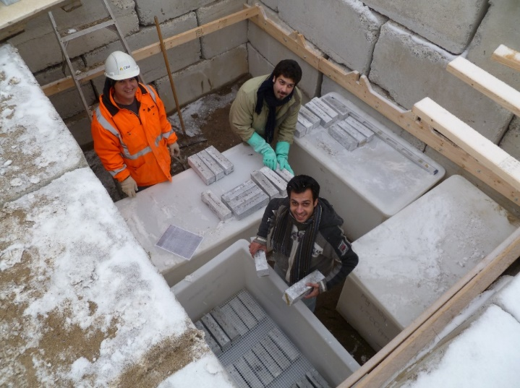
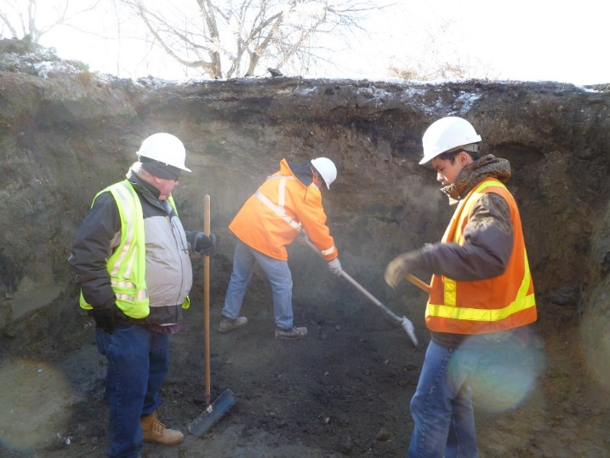
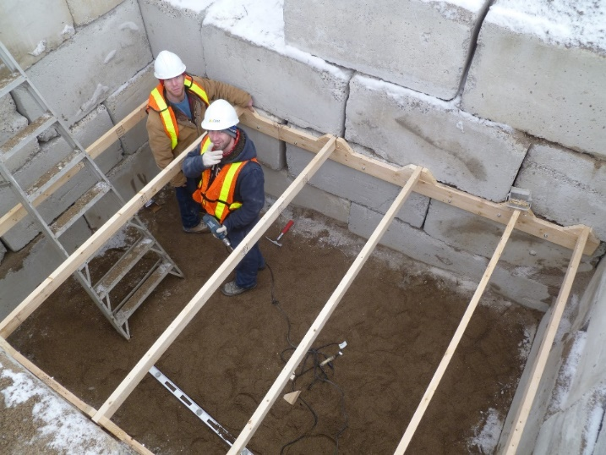
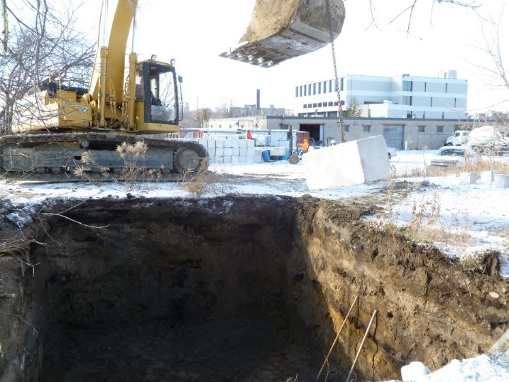
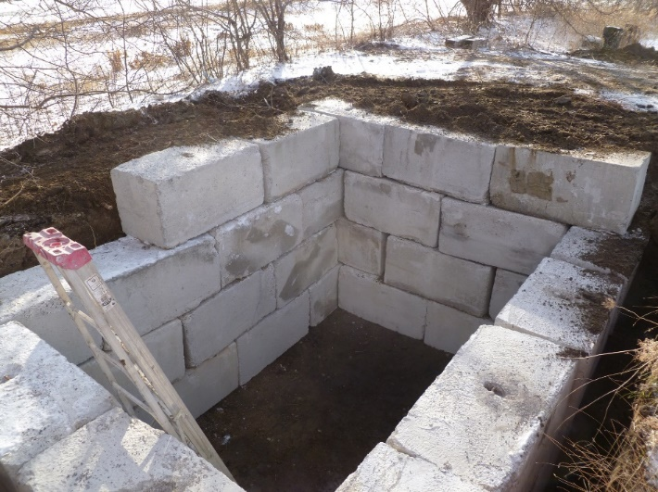
The “Vault”
2010- Doug Hooton’s Vault- “One-of-a-kind”
Over 1000 specimens in various storage solutions
Notes:
At the outset…there was resistance to adopt PLCs.
Replacing failing bars with others. PLC are performing the same as OPC
Durability work was going to be required to satisfy specifiers, concrete producers…and cement producers
We needed to convince ourselves that this was the right thing to do.
Hundreds of mixes with over 1000 specimens stored in various solutions.
Re-opened annually and put back for long-term cool storage.

Slide 40
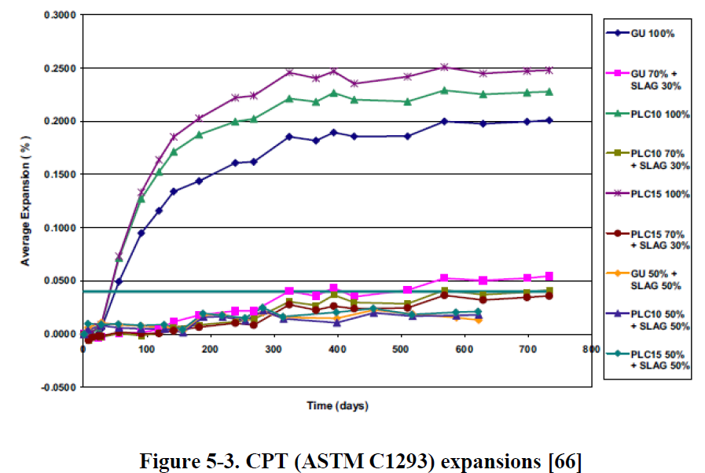
Recent Slag Cement with PCL
ASR Testing
CALTRANS: Impact of the Use of Portland-Limestone Cement on Concrete Performance as Plain or Reinforced Material (W.J.Weiss, et al, 2021)

Slide 41
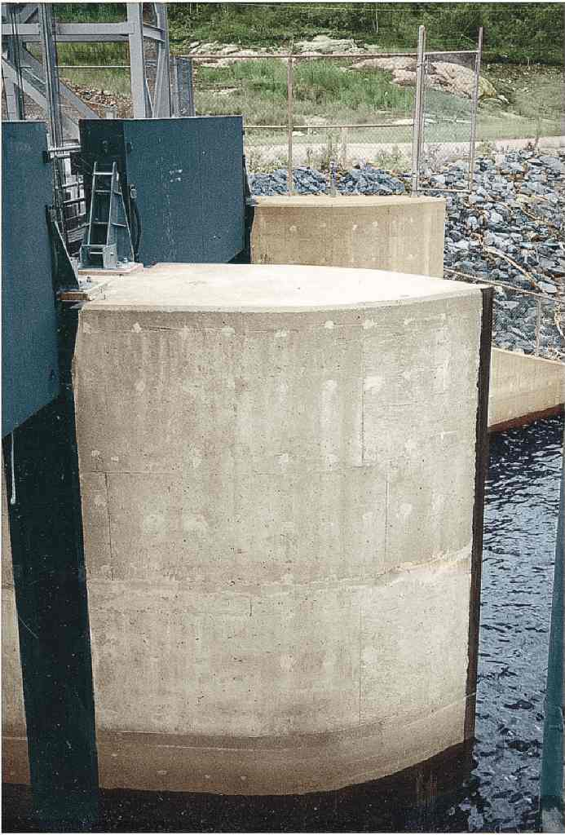
ASR: Steephill Falls Spillway on Magpie River, Ontario
50% Slag Concrete made with ASR aggregate is in excellent condition after 30 years.
There was also no petrographic evidence of any ASR activity after 15 years.
A nearby highway bridge made with the same aggregates and only Portland cement had cracked due to ASR by 15 years
Hooton et al 2000

Slide 42
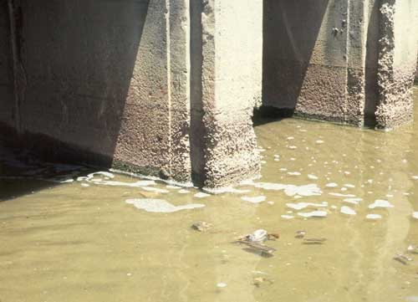
Slag Cement Resistance to
Sulfate Attack
The use of slag cement is an extremely effective way of reducing risk of deterioration.
  Reduces the total amount of C₃A in the system.
  Reduces concrete permeability, making it harder for sulfates to penetrate into concrete.
  Reacts with Ca(OH)₂ to form additional calcium silicate hydrate reducing the Ca(OH)₂ in the system.
  (Sulfate Attack, as shown in this photo, can be mitigated.)
Photo Courtesy of the Slag Cement Association (SCA)

Slide 43
Effect of Slag Cement on Sulfate Resistance
Immersion Period (years)
0
1
2
3
4
5
6
7
8
9
ASTM C 1012
Control (no slag)
Type I PC with 11.8% C₃A
0.20
ASTM 12m Limit for
High Sulfate Resistance
40% Slag
Expansion (%)
50% Slag
0.10
65% Slag
5%-Na₂SO₄ solution
Changed periodically
0
0
1000
2000
3000
Immersion Period (days)
43
Hooton & Emery, ACI MJ1990

Slide 44
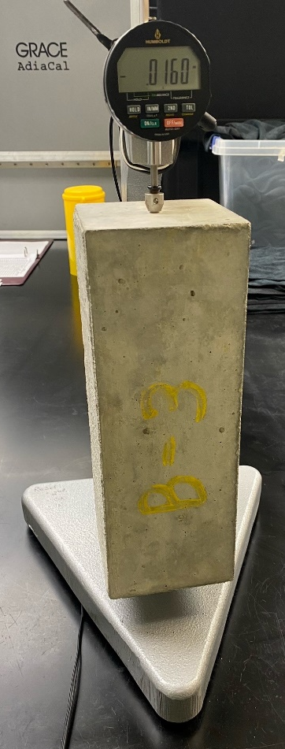
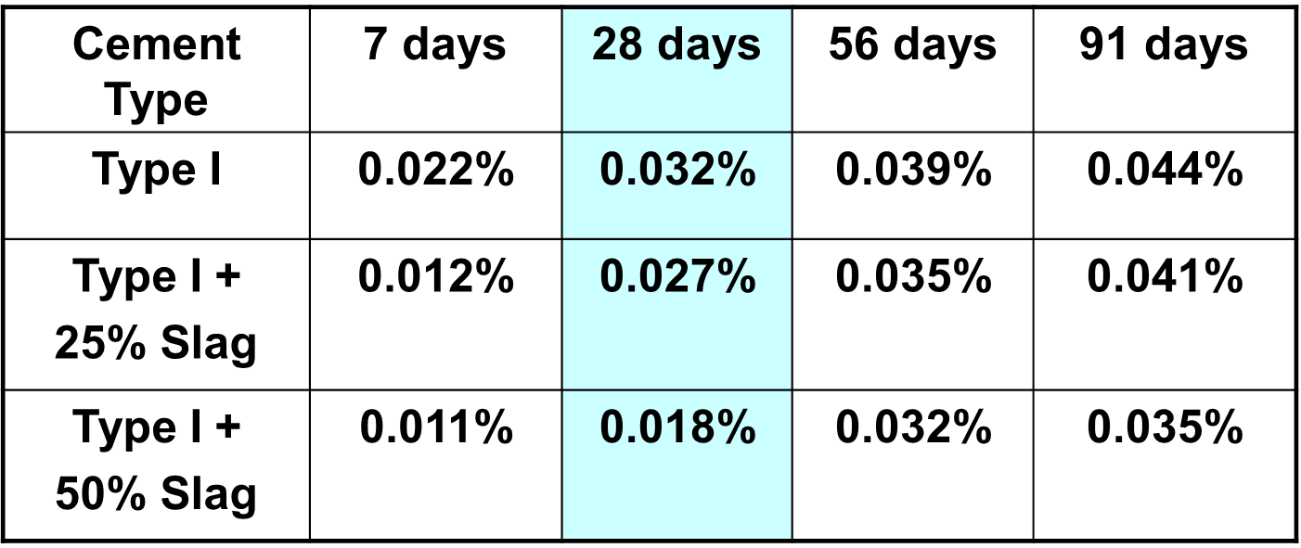
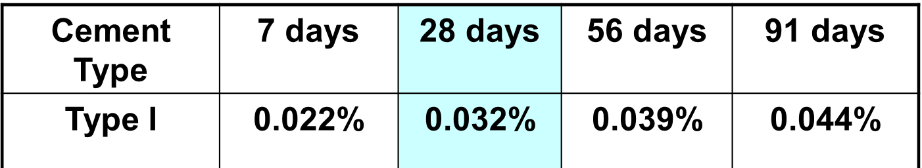
Drying Shrinkage
7 Days Moist Curing then dried at 50% rh
500 pcy total CM (300kg/m³) at 0.55 W/CM ¾” (20 mm) aggregate
Hooton & Angel, 2006
44

Slide 45
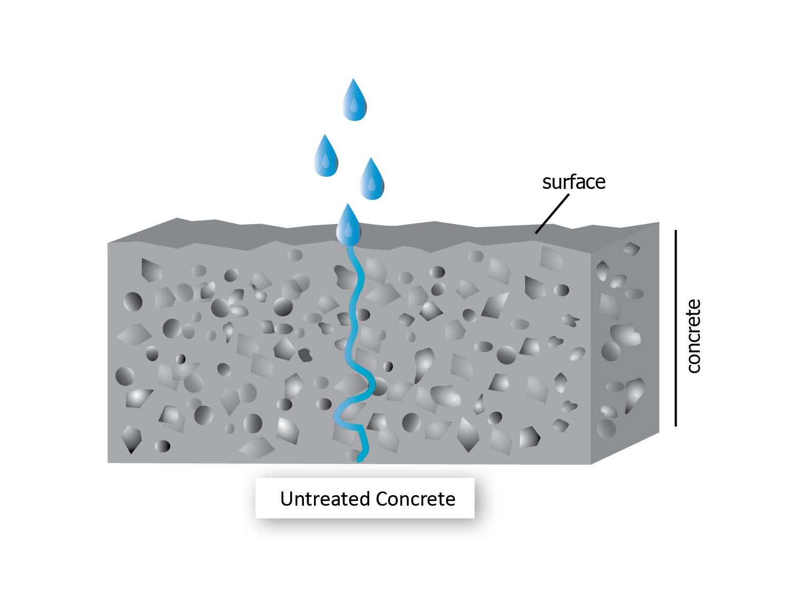
Concrete Permeability
Permeability: measure of how easy it is for water, air and other substances such as chloride ions to enter concrete
Larger pores allow easier entry, while smaller pores decrease the rate
Measured with various methods:
  Rapid chloride permeability test – ASTM C1202 “Electrical Indication of Concrete's Ability to Resist Chloride Ion Penetration”
  Penetration test – AASHTO T 358-17 “Standard Test for Surface Resistivity Indication of Concrete’s Ability to Resist Chloride Ion Penetration”
  Formation Factor – The Standard Method of Test for Electrical Resistivity of a Concrete Cylinder Tested in a Uniaxial Resistance Test (AASHTO TP119)

Slide 46
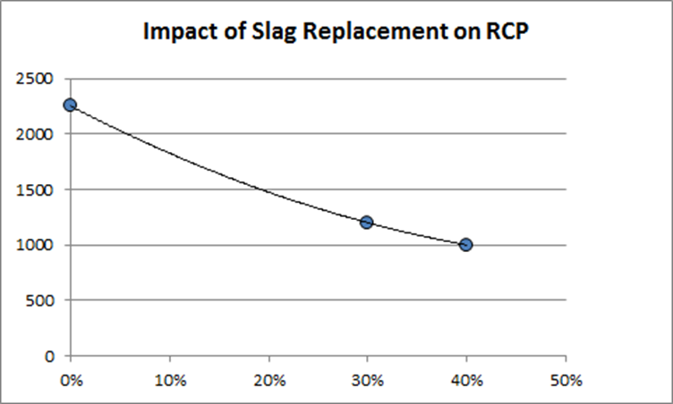
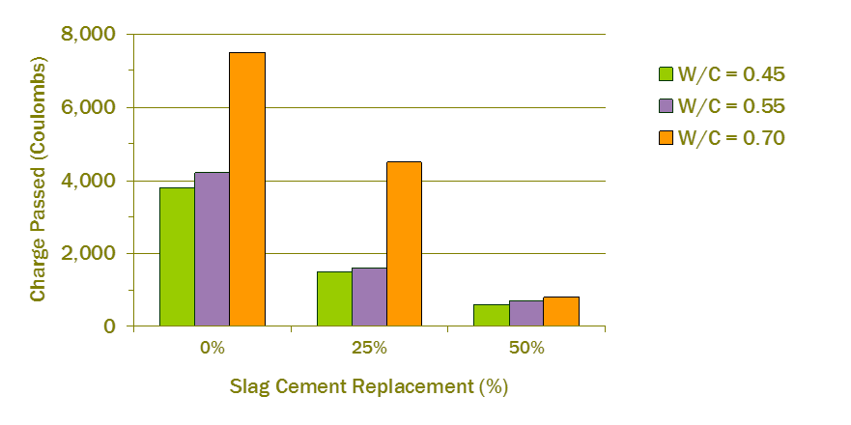
Permeability Testing
ASTM C1202

Slide 47
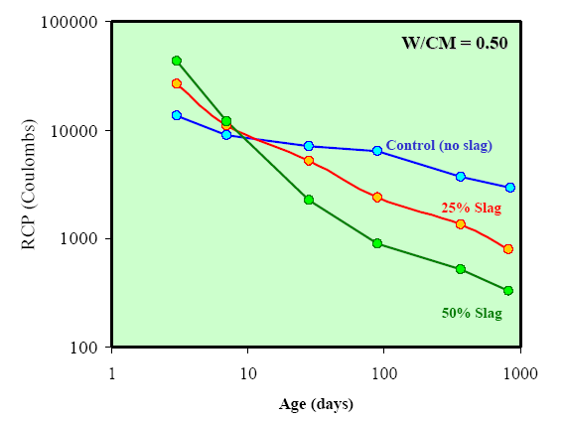
Effect of Age on Coulombs with Slag Cement
ASTM C1202
47
M. Thomas data

Slide 48
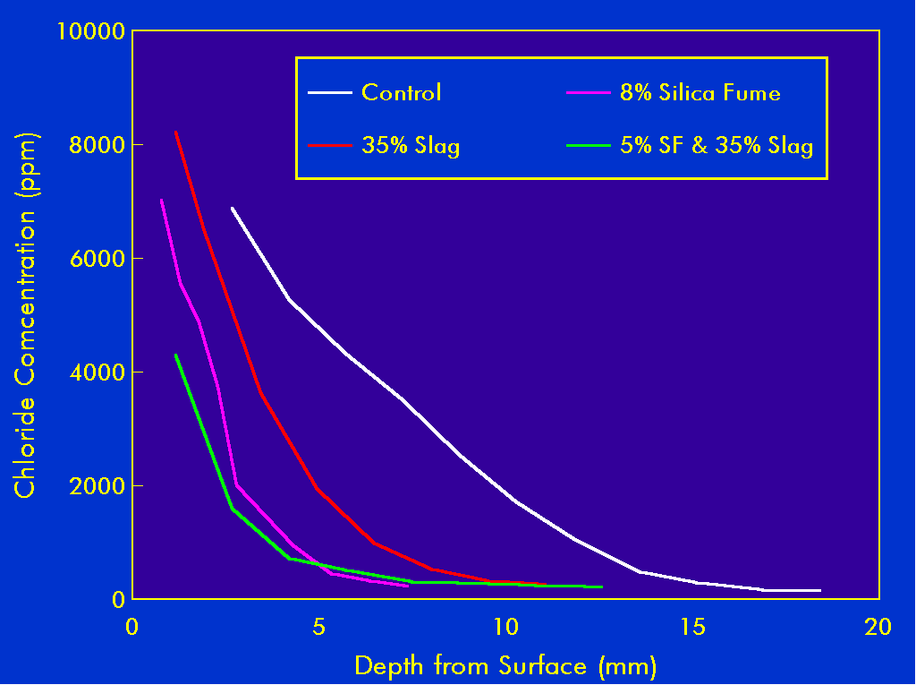
Chloride Ingress measurement on concrete pavements after 2 years (Picton, ON)
Portland Cement Mix
35% Slag Mix
35% Slag + 5% SF
(40 Day Chloride Ponding Results on Cores, ASTM C1556)
Bleszynski, Hooton, Thomas, 2001

Slide 49
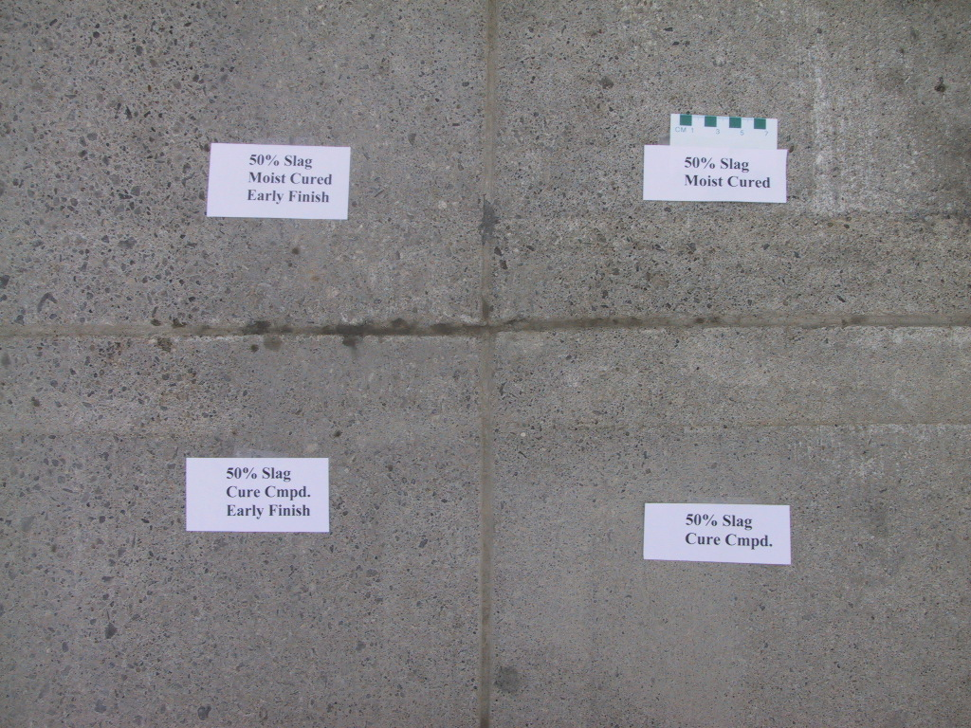
50% Slag industrial concrete pavement slabs after 10 years field exposure to F/T and de-icers
Boyd & Hooton ASCE. J. Matls in Civil Eng. 2009
49

Slide 50

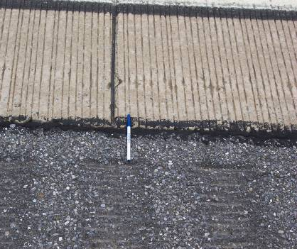
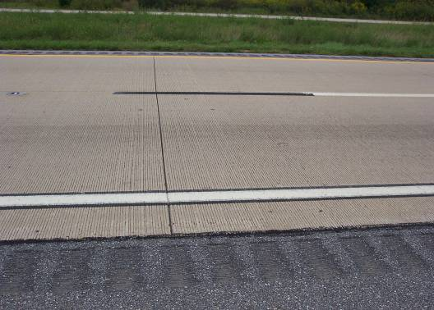
Delaware:
Route 1 SB 10 year old slag pavements,
35 and 50% slag cement
50

Slide 51

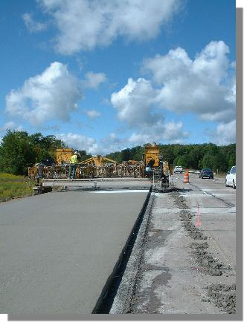

Applications Using Slag Cement
www.slagcement.org

Slide 52
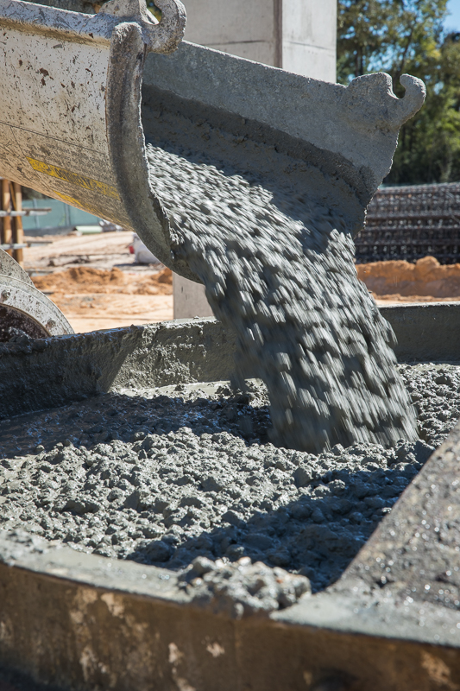
Ready Mixed Concrete Applications
  Self Consolidating Concrete (SCC)
  High Performance Concrete
  Mass Concrete
  Highway Paving & Airports
    Roller Compacted Concrete (RCC)
  Controlled Low Strength Material (CLSM)
www.slagcement.org

Slide 53
Ready Mixed Concrete Benefits
Using slag cement to replace a percentage of portland cement improves the properties of ready mixed concrete.
Measurable improvements include:
Better concrete workability and consistency
Easier finishability
Higher compressive and flexural strengths
Lower permeability
Improved resistance to aggressive chemicals
More consistent plastic and hardened properties
Lighter color

Slide 54

Self Consolidating Concrete (SCC)
Applications include:
Heavily reinforced sections
Precast & post-tension applications
Architectural concrete
Smooth surfaces with reduced bug-holes
Mass concrete placements
Slag cement concrete supplied by Central Concrete, San Francisco, CA. Award winning San Francisco Public Works

Slide 55

High Performance Concrete
Higher Compressive & Flexural Strengths
  Slag cement increases the ultimate strength of conventional concrete and is often a vital component in producing high strength concrete.
Lower Permeability
Alkali Silica Reaction (ASR) Mitigation
Mitigation of Sulfate Attack

Slide 56
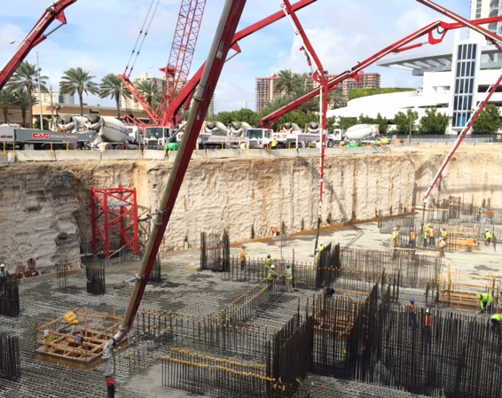
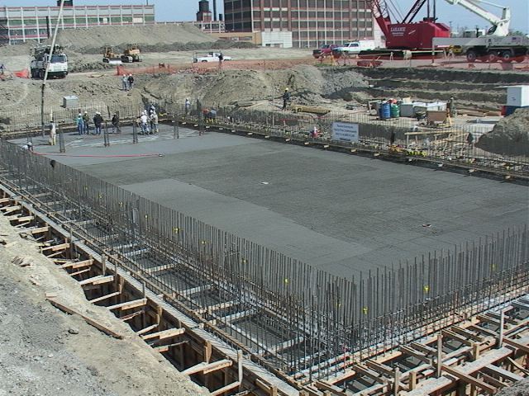
Mass Concrete
Lower heat of hydration:
15% to 50% lower than portland cement concrete
Typical 50% to 80% replacement rates
High performance properties
Strength & placement
Factors influencing max concrete temps:
  Quantity, fineness and composition of the cementitious materials
  Aggregate content and size
  Shape and volume of the concrete element (geometry)

Slide 57
Rate of Heat Liberation at 27C (80F) for different levels of slag
(Roy & Idorn 1982)

Slide 58
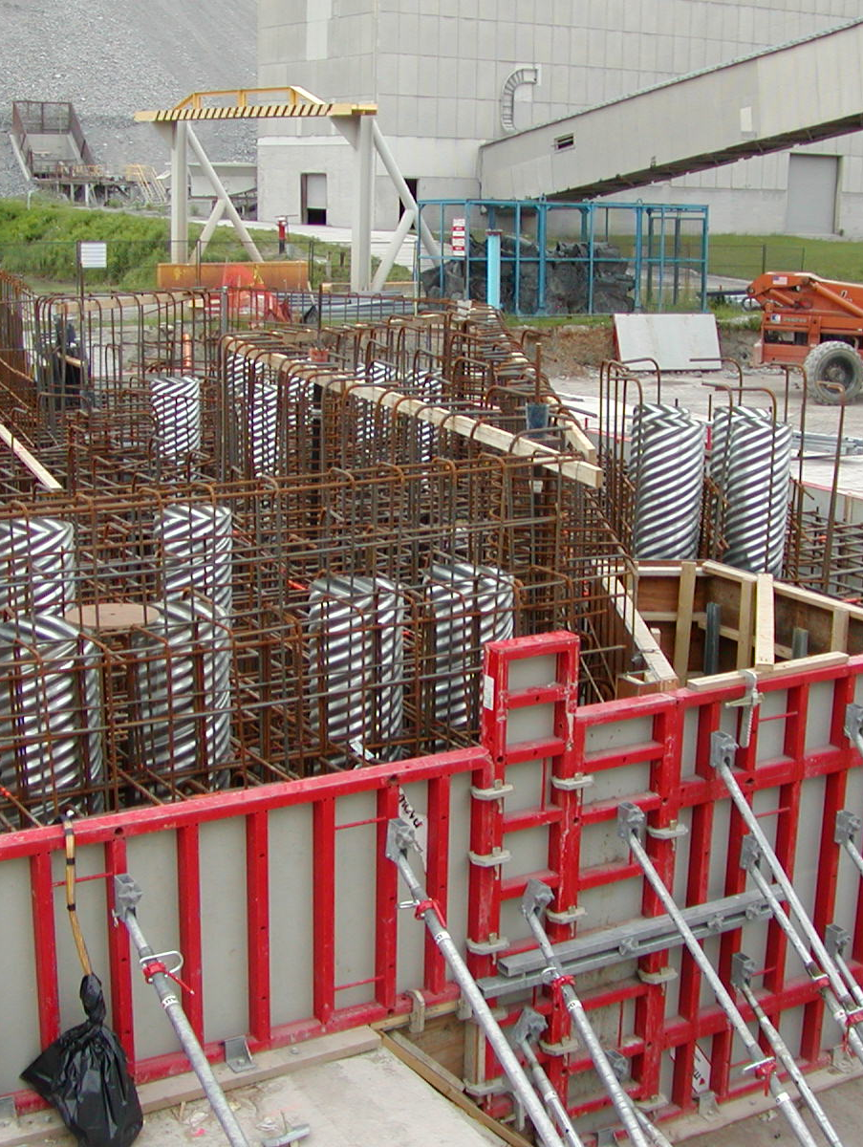
Mississauga, ON
VRM Mass Foundation June 2006
1046 yd³ mass pour
(46x46x16ft thick)
50% slag: 50% GU (Type I) Cement
0.45 W/C ratio, 590 lb/yd³
¾” coarse aggregate, slump 3” 5-8% air.
Strengths (MPa): 7.1@1day, (1030 psi)
28.5@7day, (4230 psi)
42.2@28day (6120 psi)
Shrinkage @ 28days: 0.038% (75x75mm prisms),
RCP: 810 coulombs @ 56days

Slide 59
8-Day Temperatures in 5 m (16.4 ft) thick VRM 50% Slag Mass Foundation
Tmax = 61C (142F)
Max. Differential ~24C (43F)
Could have been further reduced with 70% slag, and larger 1 ½” aggregate

Slide 60
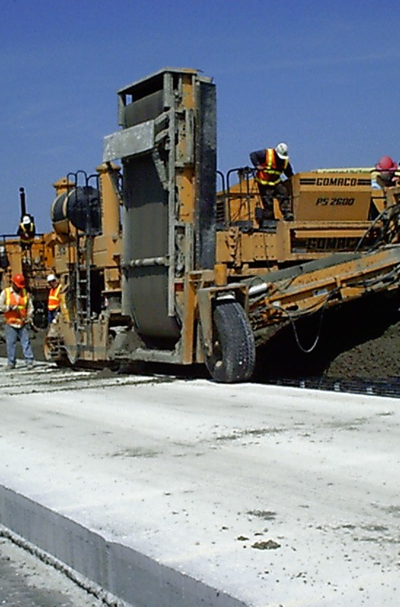
Benefits of Slag for Pavements
Advantages of Slag Cement Include:
Improved placement performance, economic value, and consistency.
Better concrete workability
Improved, easier finishability
Higher compressive and flexural strengths
Lower permeability and resistance to chemical attack
Greater consistency in plastic and hardened properties
Lighter color: Reduced Heat Island effect and lighting requirements.

Slide 61
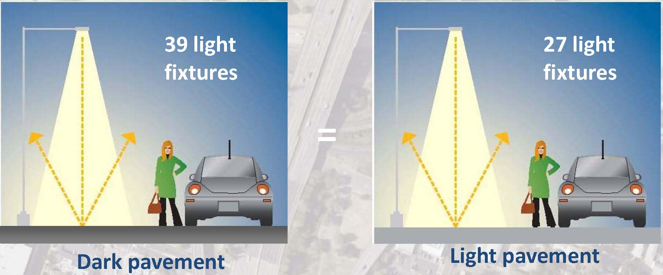
Slag Cement Concrete Pavements are Lighter and Brighter
The use of slag cement in pavements can reduce street lighting costs by up to 35%.
Source: ACPA

Slide 62
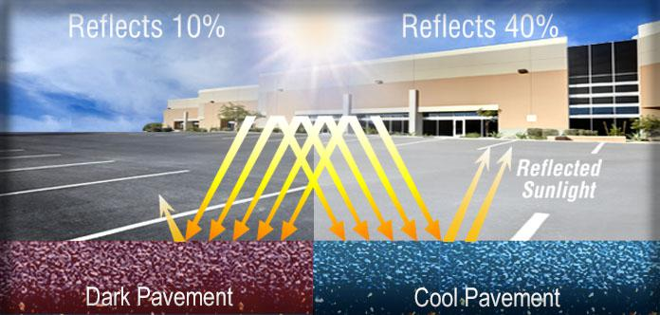
Lighter Pavements are Cooler; Reducing Urban Heat
Slag cement raises the surface albedo of concrete which indicates higher reflectivity
Surface albedo, radiative forcing, climate impacts and concrete pavements are topics of recent research by MIT Concrete Sustainability Hub - https://cshub.mit.edu/pavements/albedo

Slide 63

Project: JFK Airport – Runway 4L-22R
Rehabilitation & Extension of JFK’s 4L-22R by Tutor Perini Const.
18 inches of concrete placed on old existing asphalt pavement
  228,000 yd³ concrete
  Type IS cement, (40% portland replacement)
12,700-foot long by 200-foot wide new runway with 40-foot wide shoulders
  Handles 25% of JFK’s annual operations

Slide 64

Precast & Prestressed Concrete Benefits
Advantages of Slag Cement Include:
Early Strengths
  Responds well to heat curing and produces early strengths comparable to, or better than, 100% portland cement mixes.
  Important for early ”form removal and movement”. Heat curing is frequently used in both operations.

Slide 65

Soil Stabilization and Full-Depth Reclamation (FDR)
Increased Rigidity
Eliminates Rutting Below Surface
Reduced Moisture Susceptibility
Reduced Fatigue Cracking
Eliminates Reflective Cracking
Re-establish profile
Thinner Pavement Section

Slide 66

Environmental Benefits of Using Slag Cement
www.slagcement.org

Slide 67

Slag Cement – A Recycled Material
Environmental - Life Cycle Inventory (LCI) for Portland and Slag Cements
Item | Units | Portland Cement | Slag Cement | Percent Savings
Virgin Material | lb/ton | 2,851 | - | 100%
Energy | MBTU /ton | 4.57 | 0.62 | 86%
Carbon Dioxide | lb/ton | 1,801 | 42 | 98%

Slide 68
Slag Cement Reduces Energy Consumption

Slide 69
Slag Cement Reduces Greenhouse Gas

Slide 70

Cement Environmental Product Declaration (EPD)
The Slag Cement Association (SCA), in partnership with ASTM International (Program Operator), developed Product Category Rules (PCR)
  PCR defines the rules and requirements for a slag cement EPD
  PCR are posted at: http://www.ASTM.org/Certification/Docs/160.PCR_ASTM_Slag_Cement_PCR_090814.pdf

Slide 71
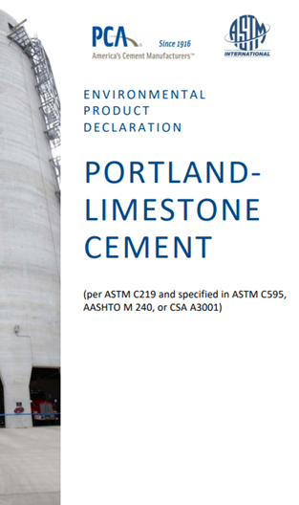
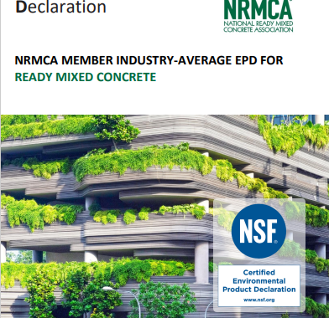


Building Product Disclosure EPD

Slide 72

SCA Calculator
The comparison to benchmark tab will show the environmental impacts compared to the NRMCA Industry EPD.
Version 3.0 released June 2022
Download Here

Slide 73
Using and Improving Concrete through the use of Slag Cement
In Summary…
Using slag cement at various replacement levels for portland cement improves:
Consistency, workability and finishability of concrete
Increases durability by
  Increasing long-term compressive and flexural strengths
  Lowering permeability
  Higher resistance to aggressive chemicals
Environmental benefits
  Recycled material
  Less energy consumption, life cycle cost efficient
  Pavements have greater reflectivity from lighter color

Slide 74
Thank You
QUESTIONS?

